Slide 1
Big screen, small screen
Basic 8 Unit 12 a

Slide 2
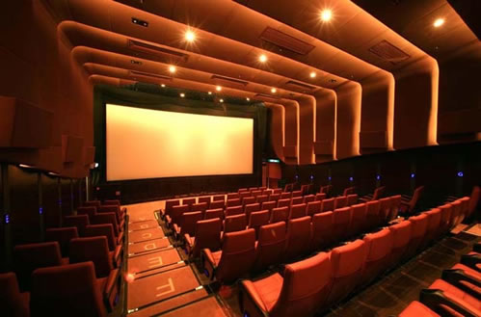

Slide 3


Slide 4
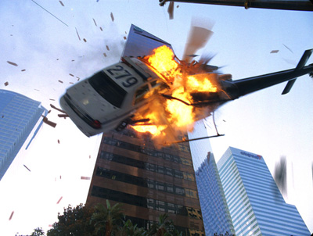

Slide 5


Slide 6


Slide 7


Slide 8


Slide 9
telephoning

Slide 10
